Slide 1


4th INTERNATIONAL CONFERENCE OF EMERGING TECHNOLOGIES (4th INCET 2023) Hosted By : Jain College of Engineering , Belagavi , Karnataka , India
Realtime News Analysis using Natural Language Processing
Paper ID: 132
South Indian Education Society
Graduate School of Technology
College in Navi Mumbai, Maharashtra

Slide 2
Contents of the Presentation
Introduction to the Project
Literature Survey
Motivation Behind the Project
Proposed System
Methodology
Implementation
Future Scope
References

Slide 3
Introduction to the Project
In today's fast-paced world, staying informed with the latest news is essential. However, with the sheer volume of news articles, it can be overwhelming to manually process all this information.
The ease of posting and sharing information has reached unprecedented levels. While this accessibility has opened new avenues for information sharing, it has also given rise to the proliferation of fake news.
News detection research is still in the early stage as this is a relatively new phenomenon in the interest raised by society. Real-time News Analysis refers to the process of automatically extracting valuable insights and trends from a vast amount of news data as it happens.

Slide 4
Literature Survey
Sr. No | Author | Title & Publication | Key findings/Gap
1 | Hangloo, Sakshini, and Bhavna Arora. | "Fake News Detection Tools and Methods--A Review." arXiv preprint arXiv:2112.11185 (2021). | The paper deals with the need the for fake news detection in a word ruled by social networks platforms and micro-blogging sites
2 | Ahmed, S., Hinkelmann, K., & Corradini, F. | Development of fake news model using machine learning through natural language processing. arXiv preprint arXiv:2201.07489.(2022). | In this paper, we learned various methods for preprocessing data in natural language, vectorization, dimensionality reduction, machine learning, and quality assessment of information retrieval. This paper also gave us the ability to contextualize the factors that need to be considered for identification of fake news.
3 | Huang, Yichong, Xiachong Feng, Xiaocheng Feng, and Bing Qin. | "The factual inconsistency problem in abstractive text summarization: A survey." arXiv preprint arXiv:2104.14839 (2021). | The paper conducted a detailed analysis related to drawbacks of making use of abstraction as means to summarize text. It explains that the most common problem with the generated summaries is the distortion or fabrication of information in the article. This inconsistency between the original text and the summary has caused various concerns over its applicability.

Slide 5
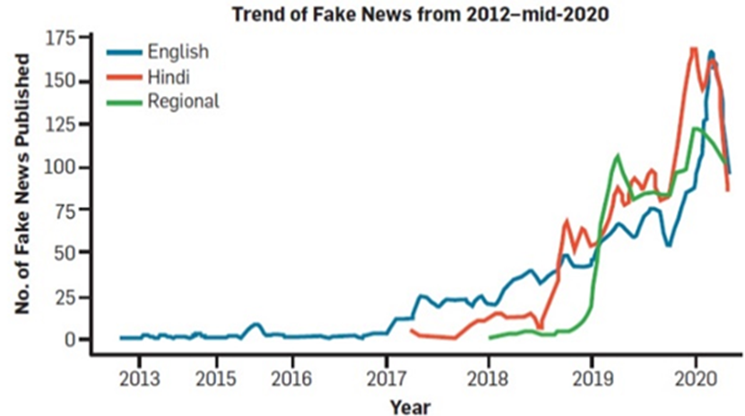
Fig. 1 Volume of fake news in India

Slide 6
Motivation Behind the Project
The fast delivery of the news cycle has only aggravated the problem of misinformation. Many organizations tend to create news articles with clickbait headlines to increase their revenue. This in turn is inconvenient for users.
The need of today’s times is to stop the rumors, especially in developing countries like India, and focus on the correct, authenticated news articles. The main objective is to detect fake news, which is a classic text classification problem and can be solved using ML and text processing techniques.

Slide 7
Proposed System
Our aim for this project is to create a web-based application that will use NLP and ML to detect fake news, summarize news articles and provide latest update.
Text classification mainly focuses on extracting various features of text and after that incorporating those features into classification.
Models were built that was able to differentiate between “Real/Fake” and “Clickbait/Non-clickbait” news. The proposed system helps to find the authenticity of the news.

Slide 8
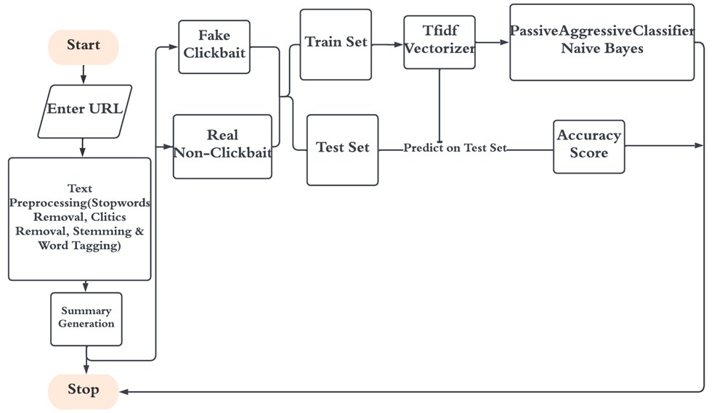
Fig. 2 Workflow of system

Slide 9
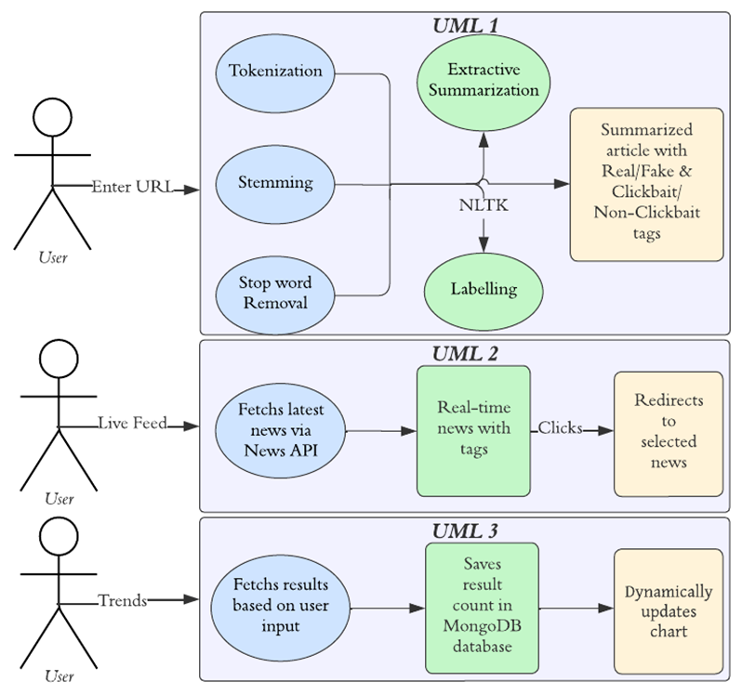
Methodology
Fig. 3 UML diagram

Slide 10
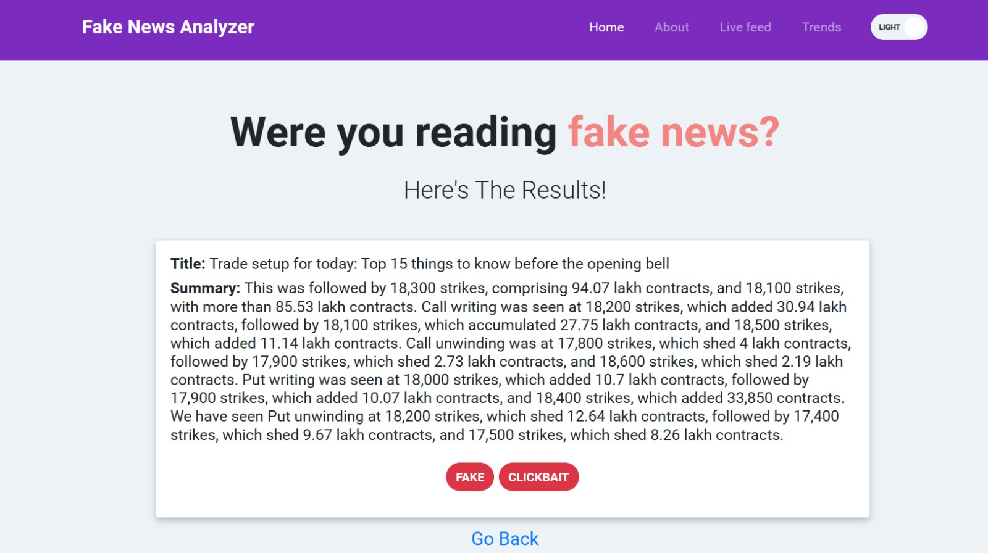
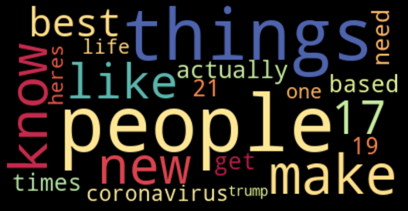
Implementation
Fig. 4 Real and Non-Clickbait Article

Slide 11
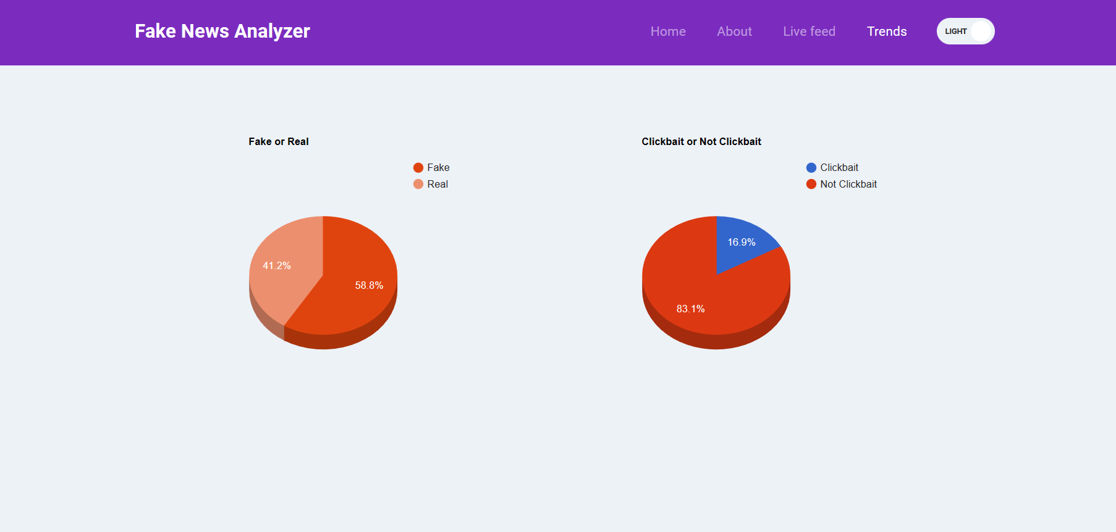
Fig. 5 Trends Page

Slide 12
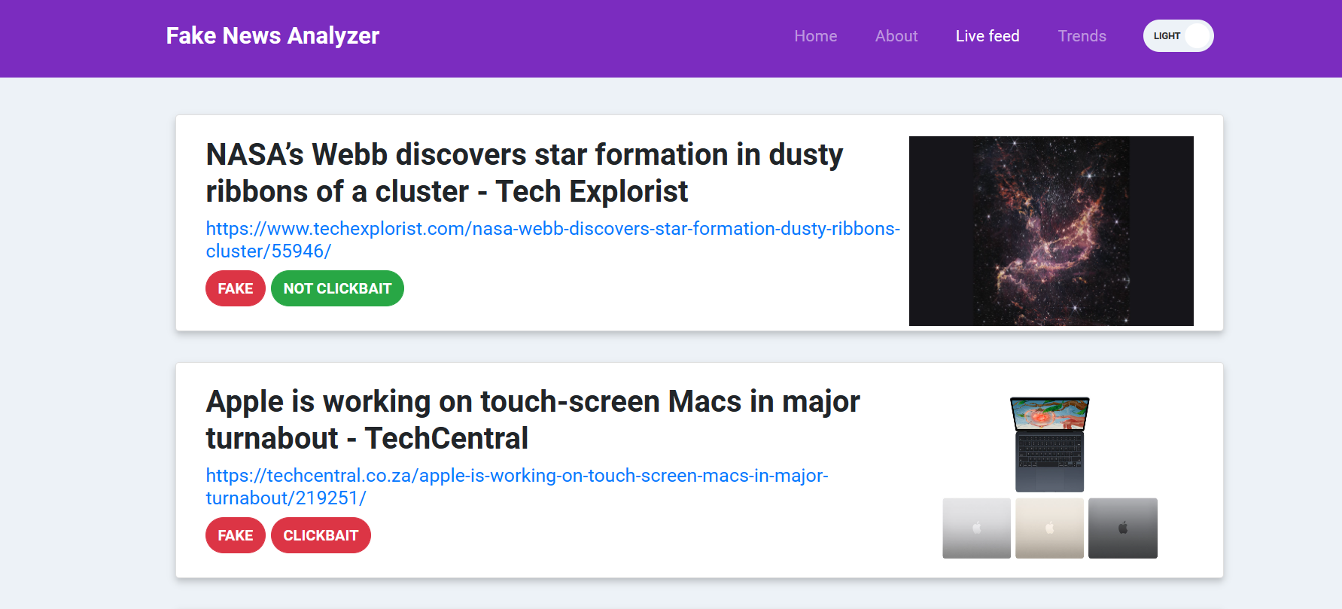
Fig. 6 Live Page

Slide 13
Future Scope
The scope of the system can be broadened by including news analysis for several different languages.
The system can be further extended to include a browser plugin which is compatible with different browsers and different operating systems.
To use Blockchain Technology for preserving the security and authenticity of each news article.
Use of Image Processing such that an image from a news article can be verified to check if it is truly authentic or fake. Also, extend the system to classify video news.

Slide 14
References
[1] Tandoc Jr, Edson C. "The facts of fake news: A research review." Sociology Compass 13, no. 9 (2019): e12724.
[2] Naeem, Salman Bin, Rubina Bhatti, and Aqsa Khan. "An exploration of how fake news is taking over social media and putting public health at risk." Health Information & Libraries Journal 38, no. 2 (2021): 143-149.
[3] Singhal, Shivangi, Rishabh Kaushal, Rajiv Ratn Shah, and Ponnurangam Kumaraguru. "Fake news in India: scale, diversity, solution, and opportunities." Communications of the ACM 65, no. 11 (2022): 80-81.
[4] Veloso, Bráulio M., Renato M. Assunção, Anderson A. Ferreira, and Nivio Ziviani. "In Search of a Stochastic Model for the E-News Reader." ACM Transactions on Knowledge Discovery from Data (TKDD) 13, no. 6 (2019): 1-27.
[5] Dizikes, P. "Study on Twitter false news travels faster than true stories research project finds humans not bots are primarily responsible for spread of misleading information." (2018).
[6] Garg, Sonal, and Dilip Kumar Sharma. "New Politifact: a dataset for counterfeit news." In 2020 9th International Conference System Modeling and Advancement in Research Trends (SMART), pp. 17-22. IEEE, 2020.
[7] Fitria, Tira Nur. "QuillBot as an online tool: Students’ alternative in paraphrasing and rewriting of English writing." Englisia: Journal of Language, Education, and Humanities 9, no. 1 (2021): 183- 196.
[8] Al Dahhan, Noor Z., Kelly Halverson, Carrie P. Peek, Dayna Wilmot, Anila D'Mello, Rachel R.Romeo, Olivia Meegoda et al. "Dissociating executive function and ADHD influences on reading ability in children with dyslexia." cortex 153 (2022): 126-142.
[9] Martinussen, Rhonda, and Genevieve Mackenzie. "Reading comprehension in adolescents with DHD: Exploring the poor comprehender profile and individual differences in vocabulary and executive functions." Research in developmental disabilities 38 (2015): 329-337.
[10] Verhoef, Ellen, Ditte Demontis, Stephen Burgess, Chin Yang Shapland, Philip S. Dale, Aysu Okbay, Benjamin M. Neale, Stephen V. Faraone, Evie Stergiakouli, and George Davey Smith. "Disentangling polygenic associations between attention deficit hyperactivity disorder, educational attainment, literacy and language." Translational psychiatry 9, no. 1 (2019): 35.

Slide 15
Thank You

